Slide 1

PC Hardware and Support Fundamentals
Lecture : 6

Slide 2

Table of Contents-
CPU Ports
Cables
Categorize Power Supplies Types and Characteristics

Slide 3

Explaining CPU Ports

Slide 4
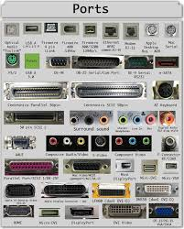
What is CPU Port?
A CPU port, often referred to as an I/O (Input/Output) port, is a hardware interface or gateway through which data is sent to or received from a CPU. These ports are used to connect peripheral devices, allowing the CPU to communicate with external hardware such as keyboards, mice, printers, storage devices, and network interfaces.

Slide 5

Types of CPU Port
Serial Port
Often used to connect a older mice, older external modems, older digital cameras, etc to the computer. The serial port has been replaced by USB in most cases. 9-pin connector. Small and short, often gray in color. Transmits data at 19 Kb/s.

Slide 6
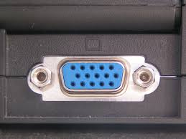
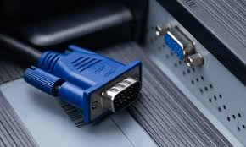
Types of CPU Port
Monitor Port (VGA)
Used to connect a monitor to the computer. PCs usually use a VGA (Video Graphics Array) analog connector (also known as a D-Sub connector) that has 15 pins in three rows. Typically blue in color.

Slide 7
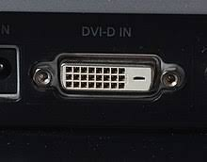
Types of CPU Port
Monitor Port(DVI)
LCD monitors work in a digital mode and support the DVI format.

Slide 8
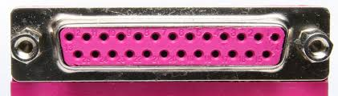
Types of CPU Port
Parallel Port
Most often used to connect a printer to the computer. 25-pin connector. Long and skinny, often pink in color. Transmits data at 50-100 Kb/s.
.

Slide 9
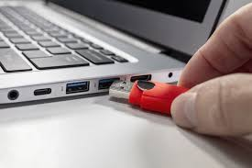
Types of CPU Port
USB Port
Universal Serial Bus. Now used to connect almost all peripheral devices to the computer. USB 1.1 transmits data at 1.5 Mb/s at low speed, 12 Mb/s at full speed. USB 2.0 transmits data at 480 Mb/s.
.

Slide 10
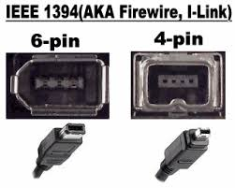
Types of CPU Port
Firewire/ IEEE 1394 Port
Often found on Apple Computers. Often used with digital camcorders. Firewire transmits data at 400 Mb/s. Firewire 1394B (the new firewire) transmits data at 3.2 Gb/s.
.

Slide 11
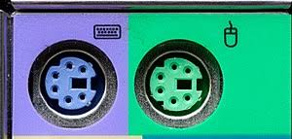
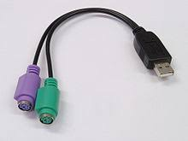
Types of CPU Port
PS/2 Port
Sometimes called a mouse port, was developed by IBM. It is used to connect a computer mouse or keyboard. Most computers come with two PS/2 ports.
.

Slide 12
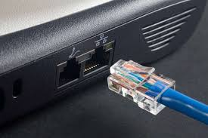
Types of CPU Port
Ethernet Port
This port is used for networking and fast internet connections. Data moves through them at speeds of either 10 megabits or 100 megabits or 1 gigabit (1,000 megabits) depending on what speed the network card in the computer supports. Little monitor lights on these devices flicker when in use.
.

Slide 13
Explaining Cables

Slide 14
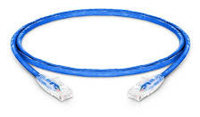
Ethernet Patch Cable
Ethernet patch cables connect network devices like computers, monitors, and IoT devices to routers or switches. Made from stranded copper for flexibility, they are ideal for small spaces. Solid core cables are less durable with frequent handling. Use CM-rated jackets for indoor cables. These short cables (Cat5e, Cat6, Cat6A, Cat8) link home devices like gaming consoles to routers.

Slide 15
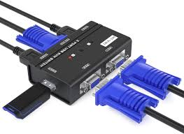
KVM Switch
KVM stands for “Keyboard, Video (monitor), Mouse.” The main function of a KVM switch is to control, switch between, and manage multiple PCs or servers via a single keyboard, monitor and mouse (also referred to as the ‘console’). At its most basic, a KVM switch is a hardware device, usually box-like, that connects one set of keyboard, monitor, and mouse to two or more PCs. The PCs are connected to the switch, and the switch is connected to the console.

Slide 16
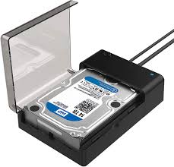
SATA dock
A SATA dock is a device that allows users to connect Serial ATA (SATA) hard drives or solid-state drives (SSDs) externally to a computer. This docking station provides a way to access and transfer data from these drives without installing them inside the computer case.

Slide 17
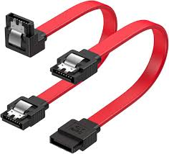
SATA III cable
SATA III cables (also referred to as SATA 3 cables) are backward compatible with earlier standards so SATA II rated devices will function but at a reduced speed. For example, a solid-state drive connected to SATA III (6 Gbps) port can read at speeds up to 550 Mbps.

Slide 18
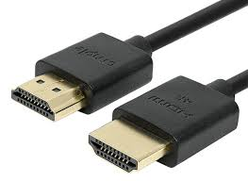
HDMI cable
An HDMI (High-Definition Multimedia Interface) cable is a type of cable used to transmit high-quality audio and video signals between devices. It connects devices such as TVs, monitors, projectors, gaming consoles, Blu-ray players, and computers to display high-definition audio and video.

Slide 19
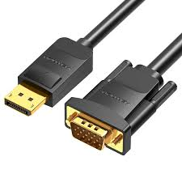
Displayport cable
A DisplayPort cable is a type of cable used to transmit audio and video signals between a computer and a display device, such as a monitor. It supports high-definition video resolutions (up to 8K and beyond) and multi-channel digital audio and offers higher bandwidth compared to HDMI, enabling higher refresh rates and resolutions.

Slide 20
Categorize Power Supplies Types and Characteristics

Slide 21

Introduction

Slide 22
Importance of Power Supplies in Computers
Power supplies play a crucial role in the operation and functionality of computer systems.
They are responsible for converting and delivering electrical power from the main power source to the various components within a computer.
Without a reliable and appropriate power supply, the computer cannot function properly, and it may even lead to system instability or damage.

Slide 23
Importance of Power Supplies in Computers (cont.)
The power supply ensures that each component receives the required amount of power in a stable and consistent manner.
It powers the motherboard, CPU, graphics card, storage drives, and other peripherals, allowing them to perform their functions effectively.
Additionally, a high-quality power supply can protect computer components from power surges, voltage fluctuations, and electrical interference, thereby extending the lifespan of the system.

Slide 24
Overview of Power Supplies

Slide 25
Definition and Role of Power Supplies in Computers
A power supply, also known as a PSU (Power Supply Unit), is an essential component of a computer system.
It is responsible for converting the alternating current (AC) from the main power source into the direct current (DC) required by the computer's internal components.
The power supply acts as a bridge between the electrical outlet and the computer, ensuring that each component receives the appropriate voltage and current.

Slide 26
Definition and Role of Power Supplies in Computers (cont.)
The primary role of a power supply is to provide a stable and reliable power source to the computer system.
It delivers power to components such as the motherboard, CPU, graphics card, hard drives, SSDs, and other peripherals.
Without a properly functioning power supply, the computer may experience system crashes, random shutdowns, or even permanent damage to its components.

Slide 27
Types of Power Supplies

Slide 28
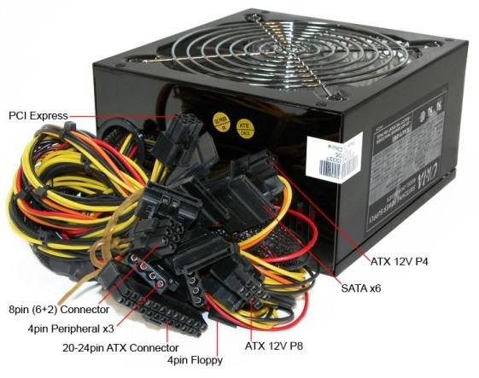

ATX Power Supply
Definition and Brief History:
ATX (Advanced Technology eXtended) power supply is a widely used standard for desktop computers.
It was introduced by Intel in 1995 as an upgrade to the previous AT (Advanced Technology) standard.
ATX power supplies standardized the connection, size, and voltage requirements for computer components.

Slide 29
ATX Power Supply (cont.)
Key Features and Specifications:
ATX power supplies typically provide +3.3V, +5V, +12V, -12V, and +5V standby voltage outputs.
They have a 20-pin or 24-pin main power connector to supply power to the motherboard.
Common features include multiple peripheral power connectors (SATA, Molex), PCI Express connectors for graphics cards, and CPU power connectors (4-pin or 8-pin).
Wattage ratings can vary, ranging from lower wattages for basic systems to higher wattages for gaming or power-hungry setups.

Slide 30
ATX Power Supply (cont.)
Common Applications and Compatibility:
ATX power supplies are widely compatible with standard ATX and Micro-ATX form factor motherboards.
They are suitable for most consumer and gaming desktop computers.
ATX power supplies provide sufficient power for a range of components, including CPUs, GPUs*, storage devices, and peripherals.
* GPU stands for Graphics Processing Unit. It is a specialized electronic circuit designed to rapidly manipulate and alter memory to accelerate the creation of images in a frame buffer intended for output to a display device. Originally developed for rendering computer graphics, GPUs have evolved to become highly parallel processors capable of performing complex mathematical and computational tasks.

Slide 31

SFX Power Supply
Definition and Purpose:
SFX (Small Form Factor extended) power supplies are designed specifically for compact or small form factor computer cases.
They provide a power solution for systems where space is limited, such as Mini-ITX or HTPC (Home Theater PC) builds.

Slide 32
SFX Power Supply (cont.)
Size and Form Factor Considerations:
SFX power supplies are smaller in physical size compared to ATX power supplies.
They typically have a depth of 100mm, making them suitable for slim cases.
SFX-L (SFX-Large) power supplies are slightly longer, around 130mm, providing higher wattage options.

Slide 33
SFX Power Supply (cont.)
Advantages and Limitations:
Advantages of SFX power supplies include their compact size, which allows for smaller and portable system builds.
SFX power supplies often feature modular or semi-modular cabling for better cable management in limited space.
Limitations may include lower wattage options compared to standard ATX power supplies, limiting their use in high-performance systems.

Slide 34
TFX Power Supply
Definition and Usage Scenarios:
TFX (Thin Form Factor extended) power supplies are designed for slim desktop cases and HTPC builds.
They are commonly used in small form factor systems where space is restricted.

Slide 35
TFX Power Supply (cont.)
Compact Design and Dimensions:
TFX power supplies have a slim and elongated form factor, with dimensions around 175mm (length) x 85mm (width) x 65mm (height).
The compact size allows them to fit into thin cases while providing power to the system components.

Slide 36
TFX Power Supply (cont.)
Advantages and Considerations:
TFX power supplies are suitable for systems that require a low-profile power solution.
They often feature low noise levels and improved energy efficiency.
However, due to their compact size, TFX power supplies typically have lower wattage options, limiting their use in high-performance gaming or workstation systems.

Slide 37
SFX vs TFX Power Supply
Both SFX and TFX power supplies adhere to specific dimensions and specifications to ensure compatibility with the corresponding cases.
However, it's important to note that SFX and TFX power supplies are not interchangeable, as they have different physical dimensions and connectors.
It's also essential to consider the power requirements of your components when selecting a power supply. Make sure the power supply you choose has an adequate wattage rating* and the necessary connectors to support your system's components (e.g., motherboard, CPU, graphics card, storage devices, etc.).

Slide 38
SFX vs TFX Power Supply (cont.)
* The maximum power output that the power supply unit (PSU) can deliver to the computer components it powers. It indicates the PSU's capacity to handle the electrical load of the system.
It's important to note that a power supply with a wattage rating lower than the system's requirements may lead to insufficient power delivery, causing instability, crashes, or system shutdowns.
On the other hand, selecting a power supply with a wattage rating significantly higher than necessary can be wasteful and may result in inefficiency, as PSUs generally operate most efficiently at around 50-80% of their maximum load.
Overall, understanding the wattage rating is crucial when selecting a suitable SFX or TFX power supply to ensure optimal performance and stability while meeting the power demands of your computer system.

Slide 39
Modular Power Supply
Introduction to Modular Design Concept:
Modular power supplies feature detachable cables, allowing users to connect only the cables required for their system configuration.
Traditional non-modular power supplies have fixed cables that may lead to cable clutter in the case.

Slide 40
Modular Power Supply (cont.)
Benefits of Modular Power Supplies:
Modular power supplies offer improved cable management by reducing the number of unused cables in the case, enhancing airflow and aesthetics.
They simplify the installation process and troubleshooting by allowing users to connect only the necessary cables.

Slide 41
Modular Power Supply (cont.)
Flexibility and Customization Options:
Modular power supplies come in different variants: fully modular, semi-modular, and partially modular.
Fully modular power supplies allow all cables to be disconnected, while semi-modular power supplies have some permanently attached cables.
Users can select the appropriate type based on their specific needs and the number of connectors required.

Slide 42
Other Power Supply Types
Server Power Supply:
Server power supplies are designed for use in server systems, which often require higher power capacities and redundancy for reliability.
They usually have multiple high-amperage 12V rails and support for hot-swappable configurations.

Slide 43

Other Power Supply Types (cont.)
Uninterruptible Power Supply (UPS):
UPS systems are designed to provide backup power during electrical outages or fluctuations.
They offer temporary power to connected devices, allowing them to shut down safely or continue operating until power is restored.

Slide 44
Characteristics of Power Supplies

Slide 45

Wattage and Power Rating
Definition and Significance:
Wattage refers to the maximum power output a power supply can provide to the computer system.
It determines the number and type of components a power supply can support.
Power rating (A power rating is a measurement of the maximum amount of power that can be used with a specific tool or device) is typically expressed in watts (W) and is an essential specification to consider when choosing a power supply.
Power Supply Calculator | Cooler Master

Slide 46
Wattage and Power Rating (cont.)
Calculating Power Requirements for a Computer System:
To calculate the power requirements, consider the power consumption of individual components such as the CPU, GPU, storage drives, and peripherals.
Manufacturers provide power consumption information in their component specifications.
Summing up the power consumption of all components provides an estimate of the total power needed for the system.

Slide 47
Wattage and Power Rating (cont.)
Impact of Underpowered or Overpowered Supplies:
Using an underpowered power supply can result in system instability, crashes, or even damage to components due to insufficient power delivery.
An overpowered power supply may waste energy and incur unnecessary costs, as the system won't utilize the full capacity of the power supply efficiently.

Slide 48
Wattage and Power Rating (cont.)
Impact of Underpowered or Overpowered Supplies:
It's worth noting that the power rating mentioned for a PC is the maximum power consumption under load. During idle or less demanding tasks, the actual power consumption of a PC can be significantly lower, as modern systems are designed to adjust power usage dynamically based on the workload to optimize energy efficiency.
PC power ratings can vary greatly depending on the intended usage and the hardware configuration. High-performance gaming PCs or workstations with powerful processors and graphics cards generally have higher power ratings, often in the range of 500 watts to 1000 watts or more. On the other hand, basic office PCs or low-power systems may have power ratings in the range of 250 watts to 400 watts.

Slide 49


Efficiency
Understanding Efficiency Ratings:
Power supplies have efficiency ratings expressed as a percentage.
Higher efficiency ratings indicate that the power supply can convert more of the incoming AC power into usable DC power.
Efficiency ratings vary depending on load conditions, with most power supplies achieving peak efficiency at around 50-80% load.

Slide 50
Efficiency (cont.)
Importance of Energy Efficiency in Power Supplies:
Energy-efficient power supplies help reduce electricity costs and contribute to environmental sustainability.
Higher efficiency means less wasted energy in the form of heat, leading to cooler and more reliable system operation.
Energy-efficient power supplies often carry certifications such as 80 PLUS, indicating their compliance with specific efficiency standards.

Slide 51
Efficiency (cont.)
Energy-saving and Environmental Considerations:
Energy-efficient power supplies can save significant amounts of energy over their lifespan, especially in systems that operate for extended periods.
Using energy-efficient components contributes to reducing carbon footprint and conserving natural resources.
When selecting a power supply, consider the desired energy efficiency level based on the system's usage patterns and environmental concerns.

Slide 52
Cooling and Noise
Cooling Mechanisms in Power Supplies:
Power supplies use cooling mechanisms such as fans and heat sinks to dissipate heat generated during operation.
Heat sinks absorb heat from internal components, while fans blow air across the heat sinks to exhaust the heat outside the power supply and the computer case.

Slide 53
Cooling and Noise (cont.)
Fan Types and Noise Levels:
Power supplies employ different fan types, such as sleeve bearing, ball bearing, or fluid dynamic bearing (FDB) fans.
Fan noise levels are measured in decibels (dB), with lower values indicating quieter operation.
Consider power supplies with larger fan sizes, improved fan designs, or fanless designs for quieter computing environments.

Slide 54
Cooling and Noise (cont.)
Balancing Cooling and Noise Considerations:
Choose a power supply with adequate cooling capabilities to prevent overheating of internal components.
Consider the noise levels of the power supply, especially in systems where noise reduction is a priority.
Balance cooling requirements with noise preferences, ensuring a suitable compromise for system performance and acoustic comfort.

Slide 55

Let’s do some exercises!

Slide 56
Exercises (cont.)
Write about the importance of power supplies in computers.
Write the definition and Role of Power Supplies in Computers.
What are the differences between ATX, SFX, and TFX power supply form factors?
Can you explain the concept of wattage in power supplies and how it affects their performance?
What is the efficiency rating of a power supply, and how does it impact energy consumption?
Write about the cooling mechanisms in power supplies.
Describe each of the different ports and explain what they are used for.
Explain types of the Monitor ports
Explain uses of KVM Switch
Which one is better, HDMI or Displayport Cable? Explain.

Slide 57

Thanks!

